Slide 1


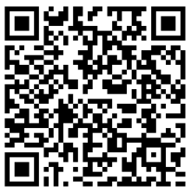
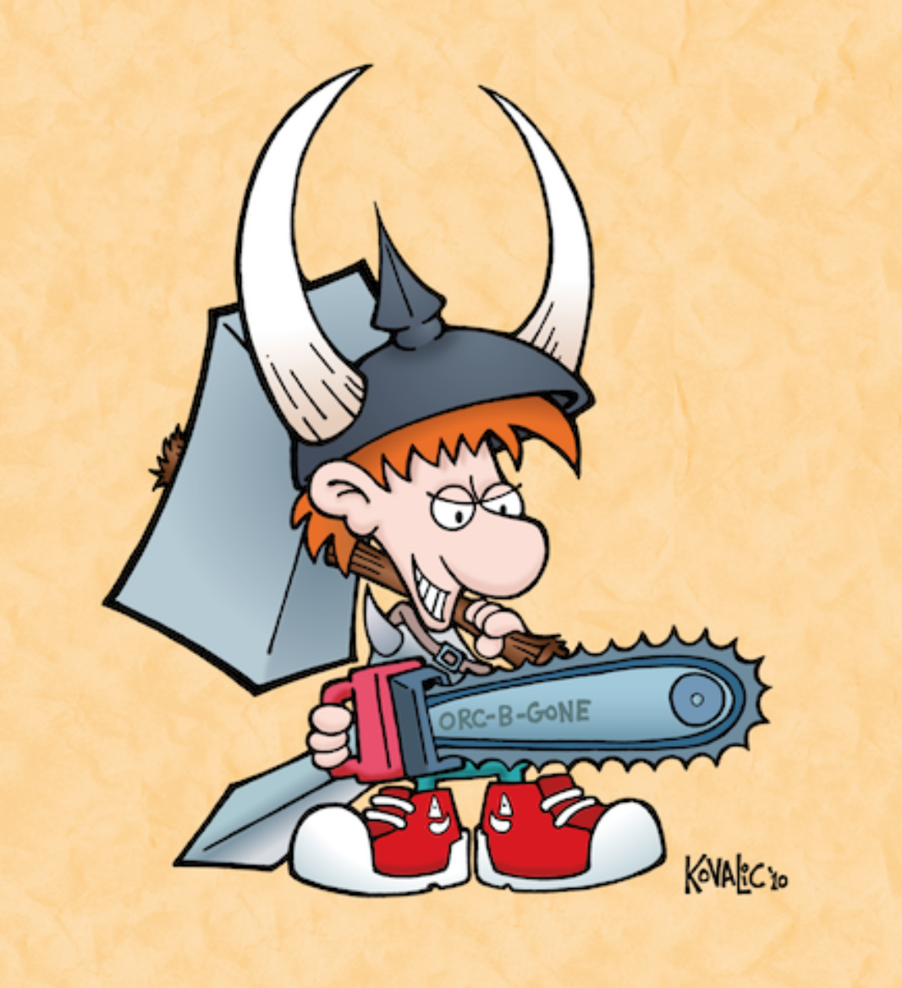
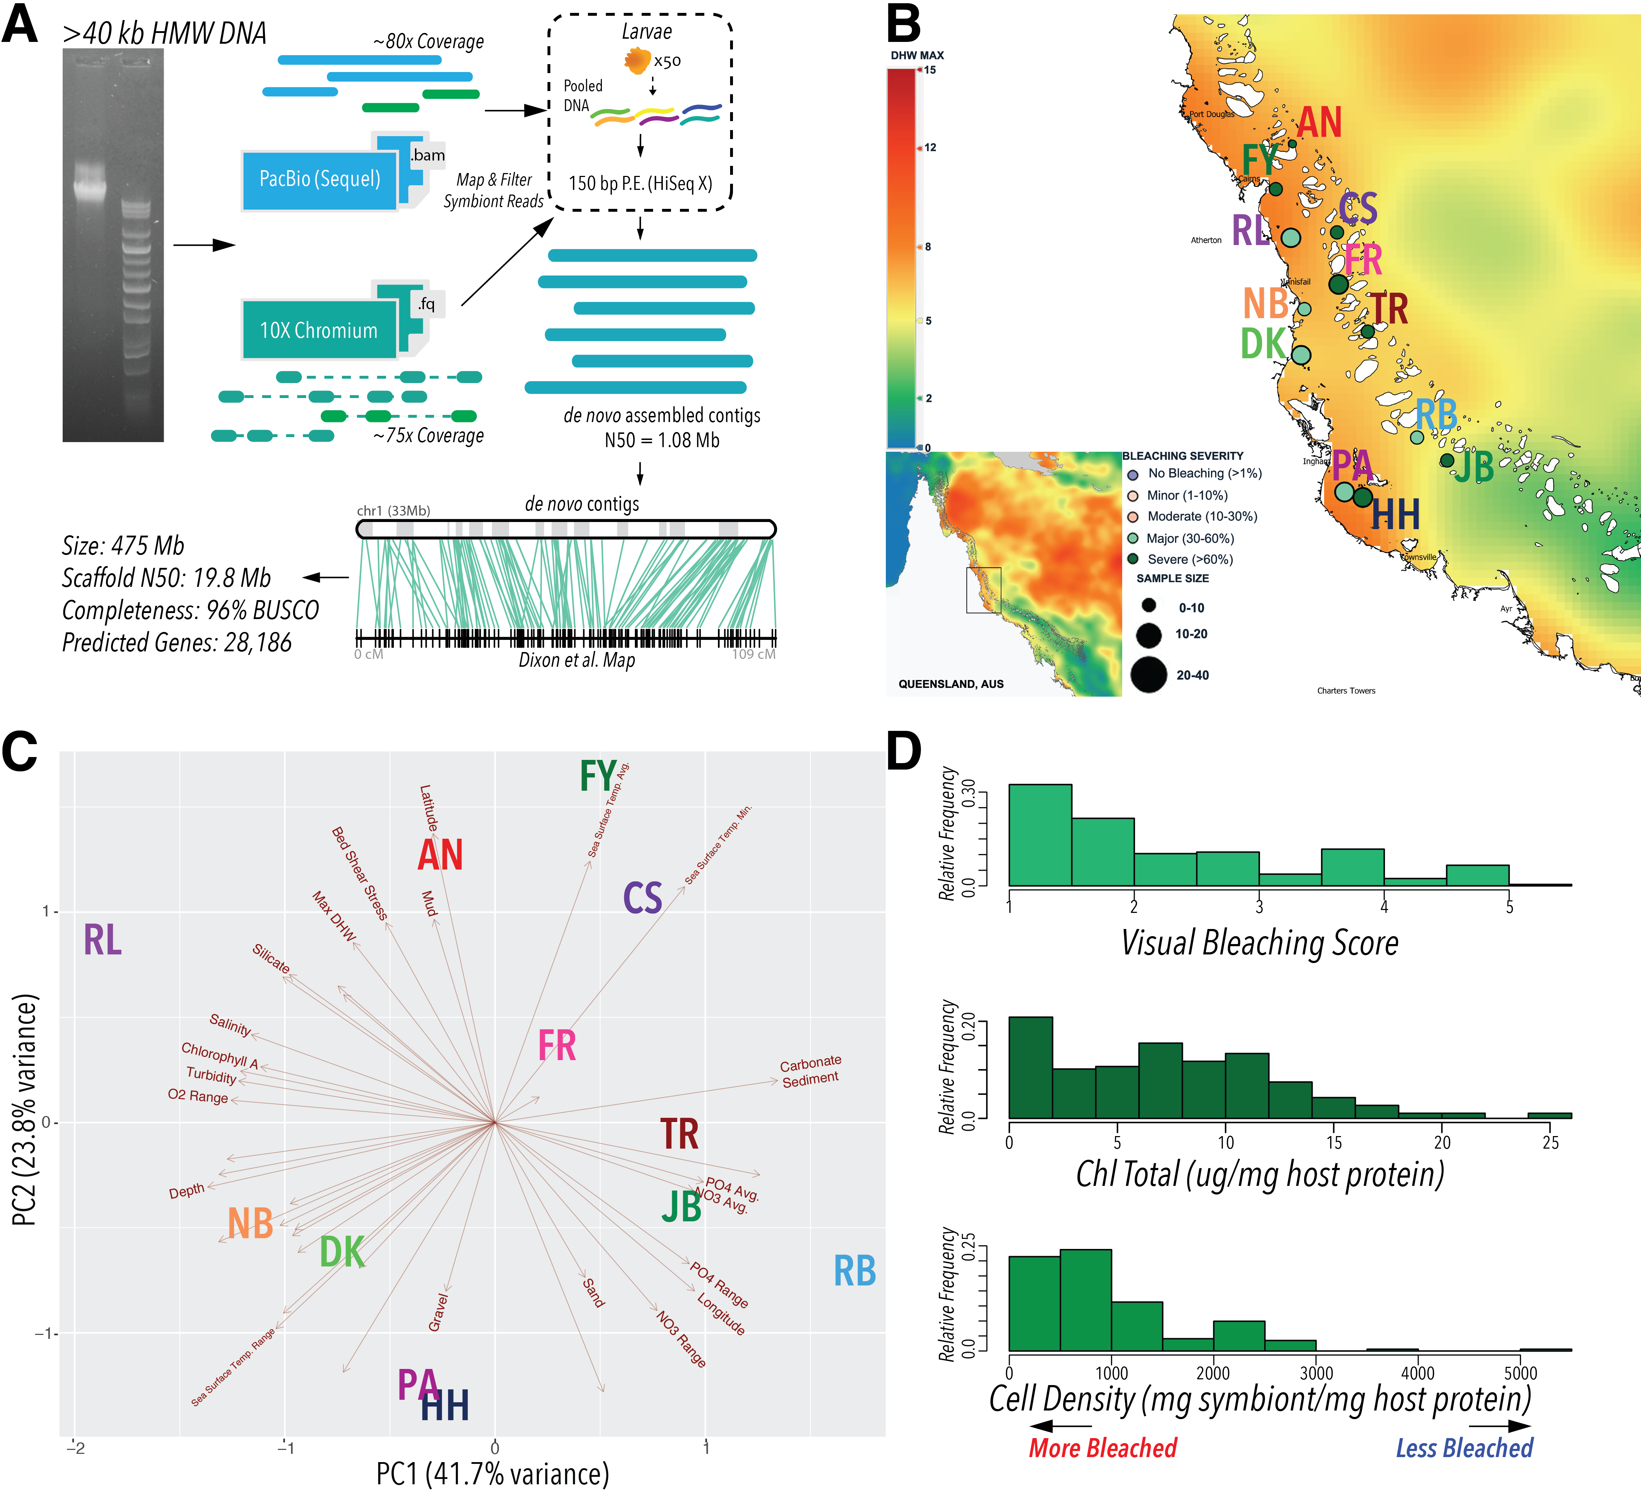
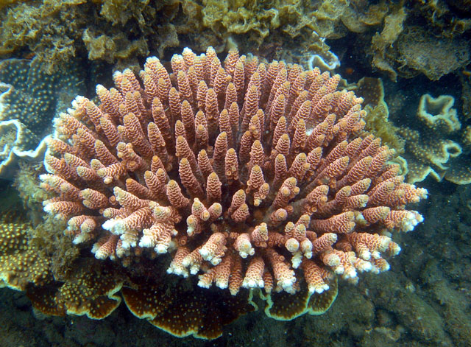

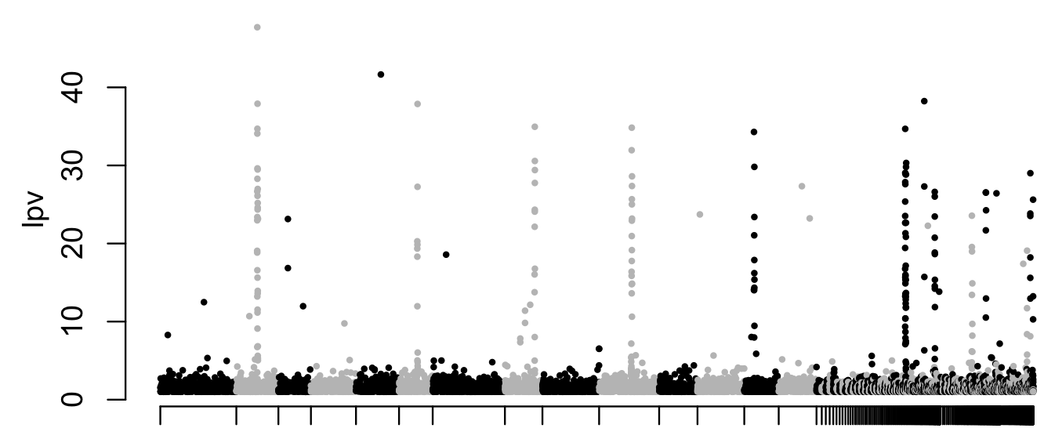
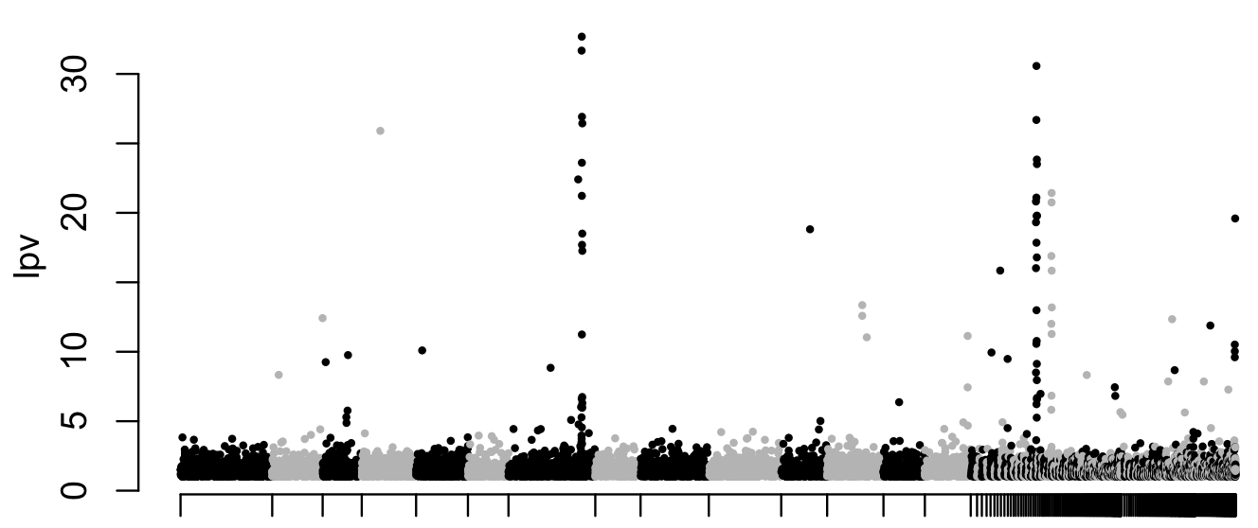
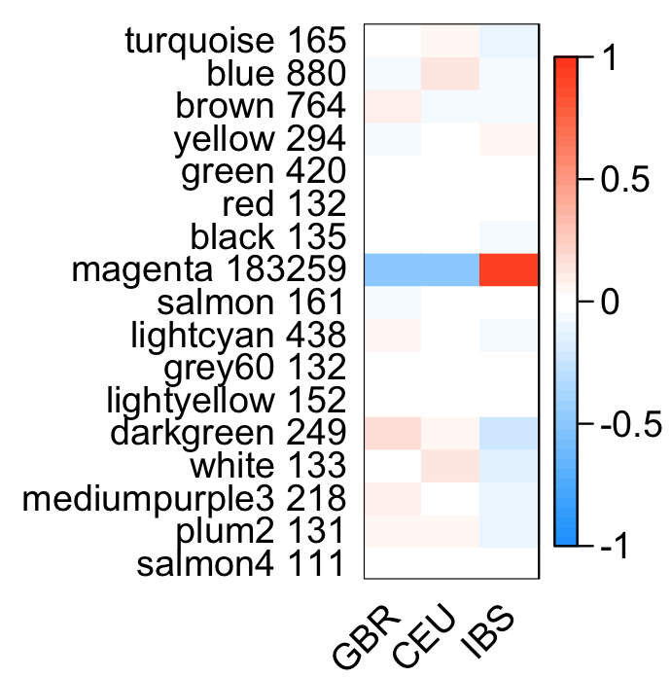
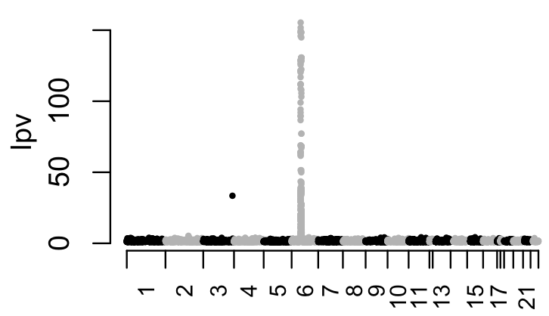
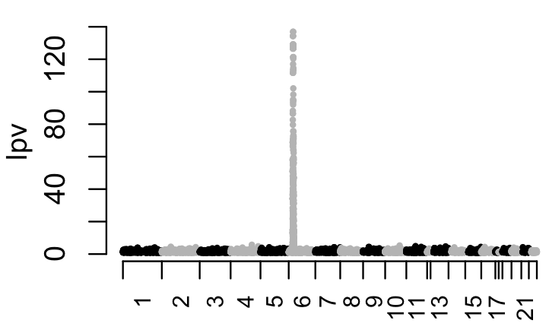
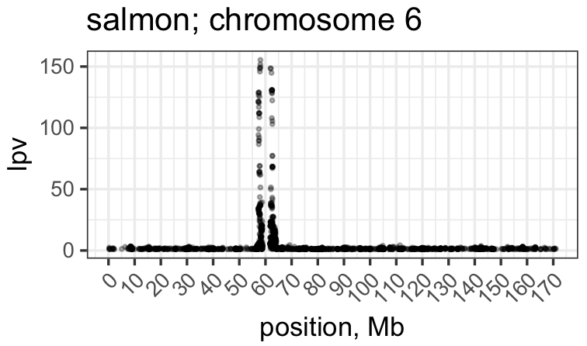
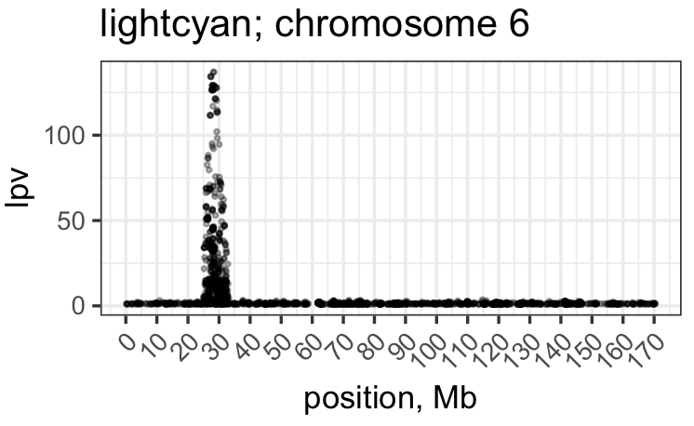
^{LD networks: unsupervised} ^{detection of} ^{polygenic selection}
¹
Mikhail V. Matz ¹, Zachary Fuller ² matz@utexas.edu
²
z0on GitHub
Main idea:
Adaptation typically involves changes of multiple traits controlled by loci distributed throughout genome
Selection should create correlation between genotypes* (i.e., LD) at these loci despite lack of physical linkage
Let’s cannibalize a correlation-based method for detecting gene co-expression networks to detect such groups of co-selected loci
Case study #1: Acropora millepora coral
193 samples, 1.5x coverage
* As long as selection pressure varies across species range
Method:
Clustering of loci based on genotypic cross-correlation
LD modules
Network distance
Turquoise module = genome-wide population structure
BAMs
”brown”: 406 SNPs, correlates with MDS1
”green”: 48 SNPs, correlates with bleaching
ANGSD
Genotype
likelihoods
log₁₀(p-value of SNP belonging to module)
log₁₀(p-value of SNP belonging to module)
Subsample loci to > physical linkage distance
48x
Posterior numbers of derived alleles
Chromosomes / unplaced contigs
Chromosomes / unplaced contigs
ngsLD
Compute pairwise correlations among loci (EM algorithm)
Case study #2: Homo sapiens (297 samples, VCF from 1000 genomes project)
ngsLD
Select loci showing R²>0.1
ngsLD
ngsLD
ngsLD
ngsLD
ngsLD
Huge ”magenta” module captures background population structure
Other modules:
Mega-extended haplotypes (>5 Mb)
(Round 1)
ngsLD
(Round 2)
GBR, CEU, IBS
number of SNPs
R²
Pericentromeric regions
Other
WGCNA
Detect correlated groups of loci (“LD modules”)
salmon
lightcyan
WGCNA
Traits measured for each sample
WGCNA
WGCNA
WGCNA
WGCNA
WGCNA
MHC locus
Match modules across subsets, aggregate results
“traits”
Conclusions so far
Explore location of modules in the genome
The method works as intended, powerfully detecting cross-correlated groups of loci based on a few hundred low-coverage samples;
Type of detected signal depends on the organism
possibly, physically unlinked loci can only become correlated in organisms that can sustain very high selection pressure (e.g., highly fecund marine creatures)
Emphasis art:
“Munchkin” card game
Designer: Steve Jackson
Artwork: John Kovalic
Explore module-trait correlations

